Slide 1
Quantum Dots
From
Foundation
to
Topological Qubits

Slide 2
The Atom
&
Its Energy Levels

Slide 3
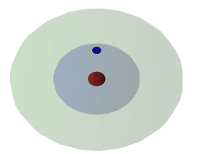

Slide 5
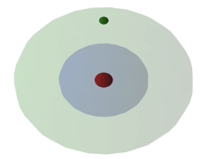

Slide 6
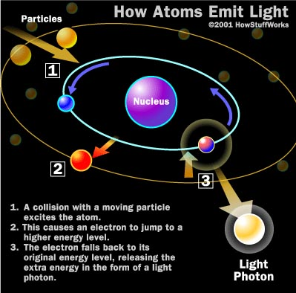

Slide 7
Bulk Matter

Slide 8
Bulk Matter - Main Features
Metals or bulk semiconductors.
Atoms are organized in a 3D lattice
Since the atoms are close - Their electron orbitals (mainly the valence) intersect
An outcome of every intersection is:
An orbital with a lower energy
An orbital with a higher energy
We have orbitals with a higher energy than the valence orbital
We have nearly continuous energy bands

Slide 9
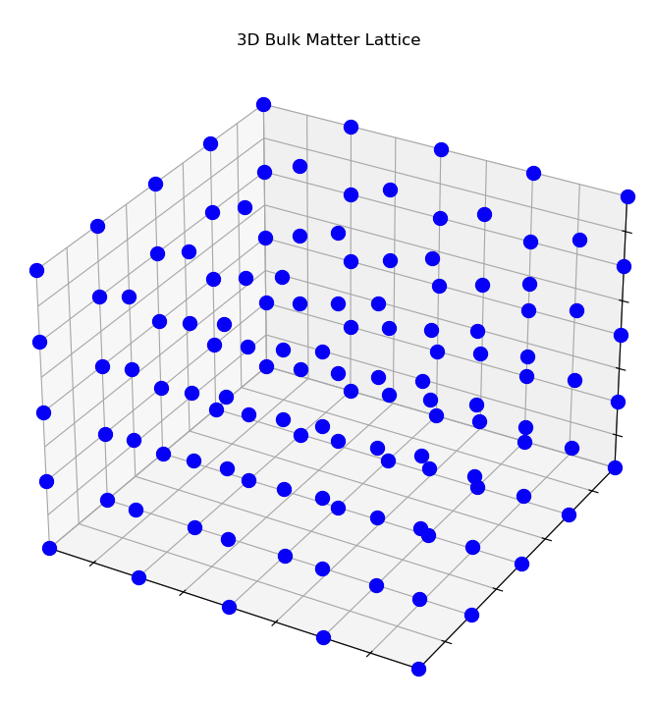

Slide 10
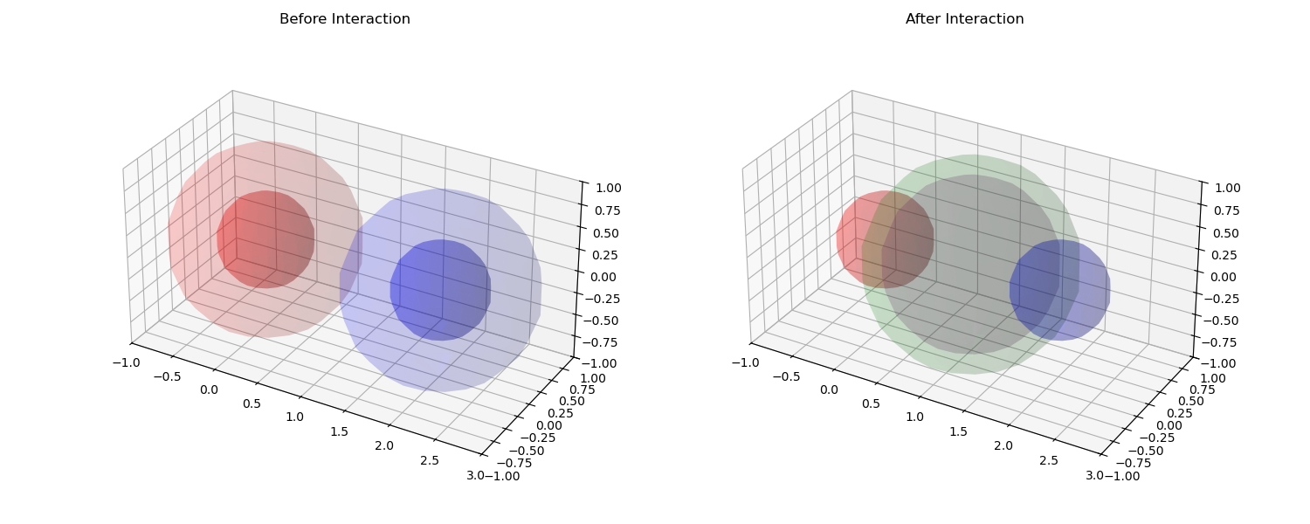

Slide 11
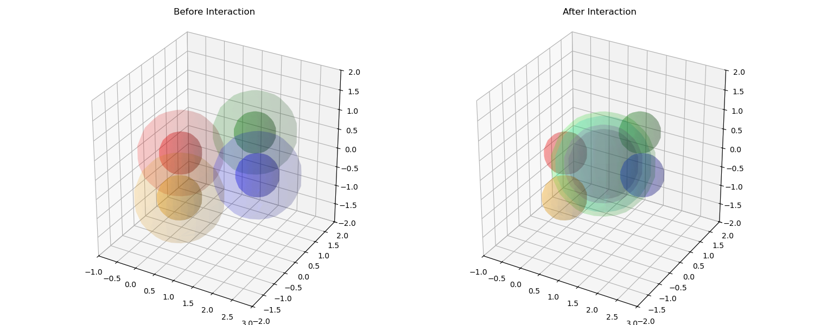

Slide 12
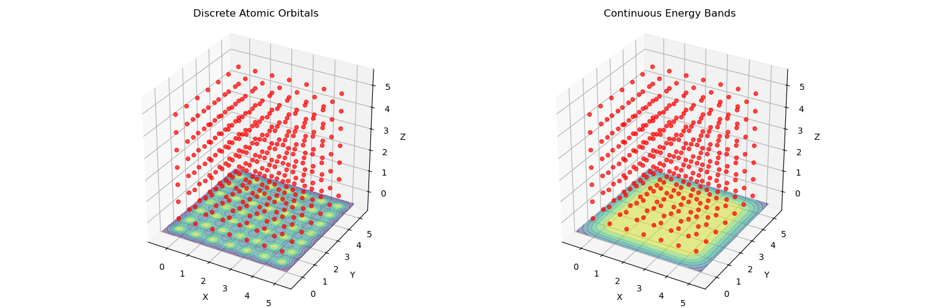

Slide 13
Quantum Dots

Slide 14
What are QD?
Quantum dots are nanoscale semiconductor structures, typically 2-10 nanometers in size
Examples
Cadmium selenide (CdSe)
Cadmium telluride (CdTe)
Indium arsenide (InAs)
Lead selenide (PbSe)
Gallium Arsneids(GaAS)

Slide 15
Quantum Dots: From Molecules to Nanocrystals
Bulk Materials: Continuous Bands:
In bulk materials, like metals or semiconductors, we have an enormous number of atoms, leading to an immense number of interactions.
These interactions result in a vast number of closely spaced energy levels, forming what we call 'continuous bands'.
Quantum Dots: Discrete Levels:
Quantum dots are nanoscale crystals, containing a finite, but controllable, number of atoms.
With fewer atoms, there are fewer interactions, and the energy levels become more spaced out, or 'discrete'.
Analogy:
Think of it like the difference between a large orchestra (bulk) producing a continuous range of sounds, and a small ensemble (QD) producing distinct notes.

Slide 16
Quantum Confinement: The Impact of Limited Interactions
Fewer Atoms, Fewer Splittings:
With fewer atoms, there are fewer interactions and therefore fewer 'splittings' of energy levels.
This results in larger energy gaps between the discrete levels.
We call this 'quantum confinement'
Electron Movement:
Electrons in quantum dots need more energy to move between these discrete levels compared to electrons in bulk materials
It's not that confinement magically creates discrete levels. It's that it removes the interactions that created the continuous bands in the first place

Slide 17
Quantum Dots: From Molecules to Nanocrystals
Bulk Semiconductor - Many atoms, huge number of orbital intersections -> energy bands are nearly continuous ,electrons can move without significant constains
Quantum Dots - Small semiconductor, Fewer atoms, less oribat interactions- >Discrete energy levels
Electrons in quantum dots need more energy to move between these discrete levels compared to electrons in bulk materials “Quantum Confinement”

Slide 18
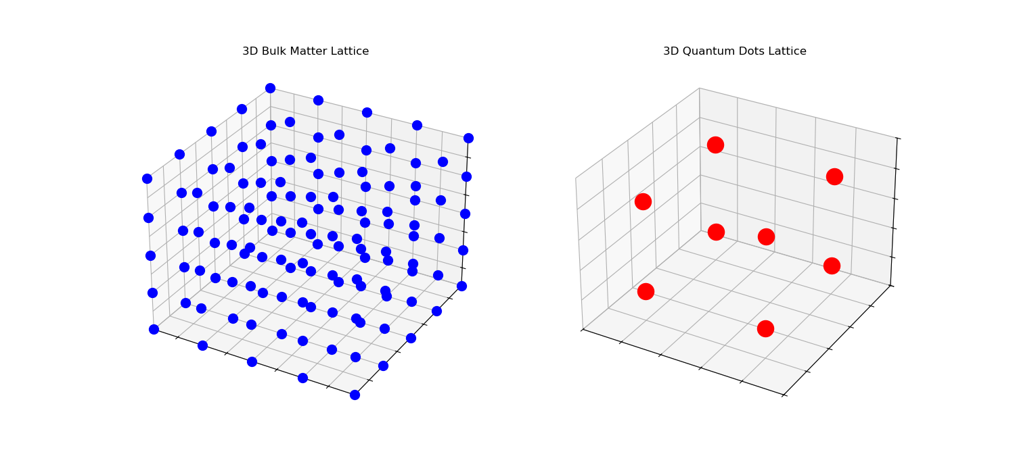

Slide 19
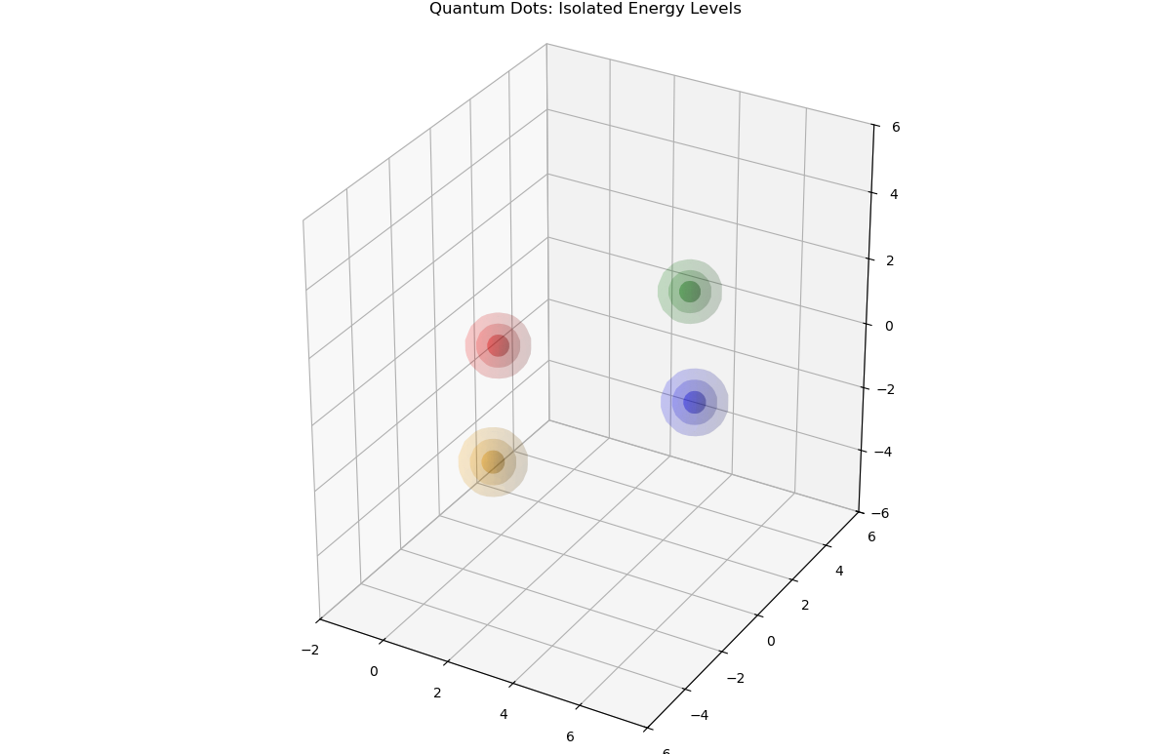

Slide 20
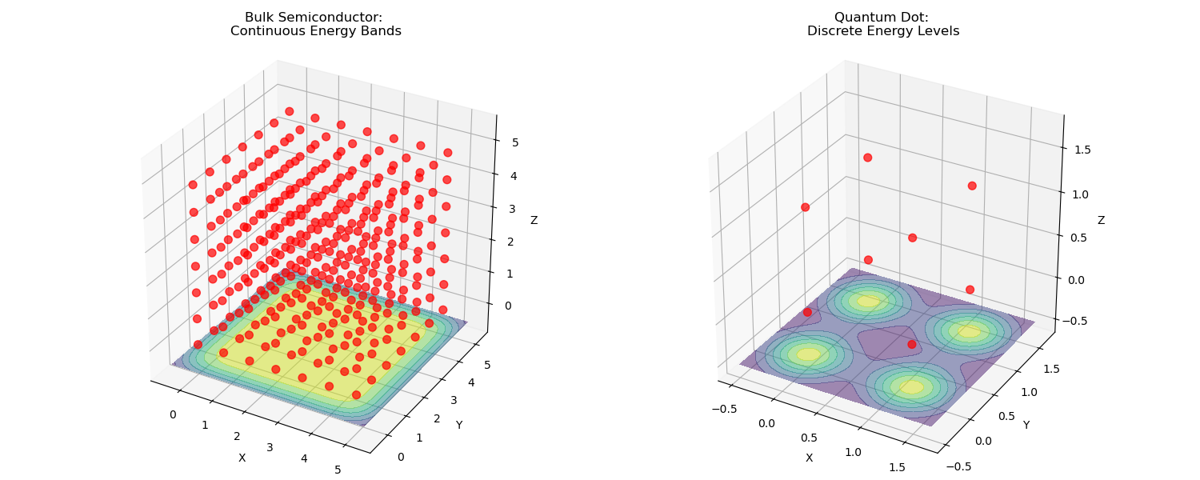

Slide 21
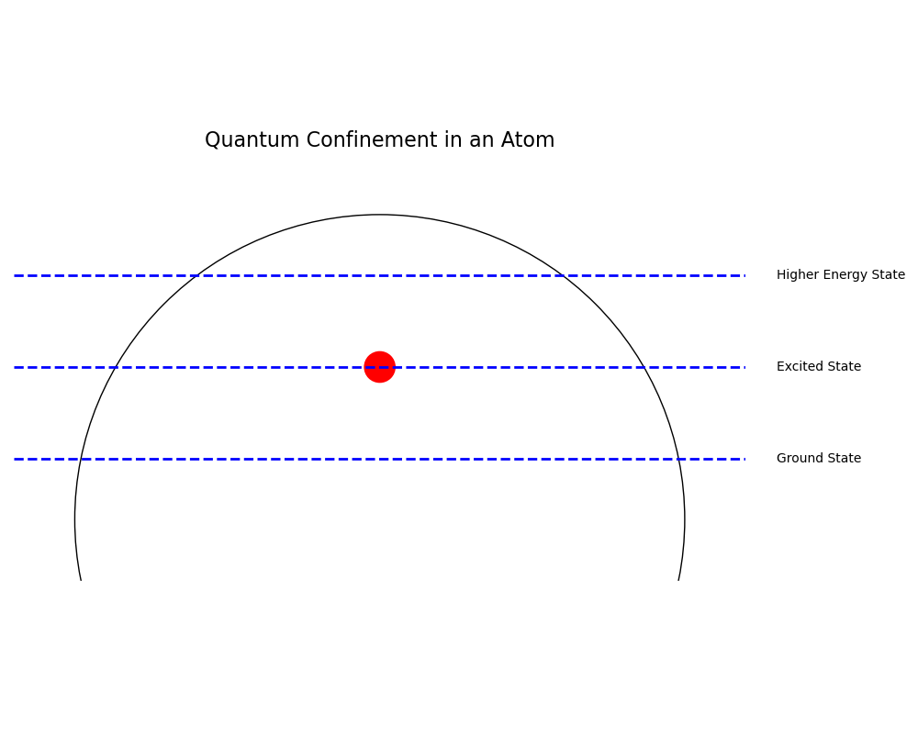

Slide 22
Tunability: The Chemist's Playground at the Nanoscale
Size and Composition Control:
The size and composition of quantum dots can be precisely controlled during synthesis.
This allows us to tailor their electronic and optical properties.
Energy Level Spacing:
The smaller the quantum dot, the fewer atoms it contains, and the more spaced out the energy levels become.
This means that we can tune the energy gap by changing the size of the quantum dot.
Optical Properties:
Quantum dots can absorb and emit light at specific wavelengths, depending on their size and composition.
This makes them useful for applications in lighting, displays, and bioimaging
Chemical Functionality:
The surface of quantum dots can be functionalized with various ligands, allowing for chemical control and integration into different systems.

Slide 23
Tunability: The Chemist's Playground at the Nanoscale
The size and composition of quantum dots can be precisely controlled during synthesis.
This allows us to tailor their electronic, optical properties and energy gap by changing the size of the quantum dot.
Quantum dots can absorb and emit light at specific wavelengths, which makes them useful for applications in lighting, displays, and bioimaging
The surface of quantum dots can be functionalized with various ligands, allowing for chemical control and integration into different systems.

Slide 24
QD Features
Semiconductors
They are a collections of atoms with orbital splitting that generate higher energy level
They have higher energy level than the valence -Conduction band
As semiconductors they have a good tunability
Atoms
They have Discrete energy levels
Electrons cannot move freely in the space as bulk matter -Quantum confinement
Light emission -Semiconductors offertunability robustness and scalability that atoms dont

Slide 25
Quantum Dot - Excitation & Light Emission
What is an Exciton?
When a quantum dot absorbs a photon (or is excited by an electrical current), an electron is energized and jumps from the valence band to the conduction band.
This leaves behind a 'hole' in the valence band, a region of positive charge.
Due to their opposite charges, the electron and hole attract each other, forming a bound pair called an exciton.
Exciton Formation and Recombination:
The exciton is an unstable, higher-energy state.
The electron and hole will naturally recombine, with the electron falling back into the hole.
This recombination releases energy in the form of a photon, which is the light emitted by the quantum dot.
Energy and Color:
"The energy of the emitted photon corresponds to the energy difference between the conduction and valence bands (the band gap).
The size of the quantum dot dictates the band gap. Smaller dots have larger band gaps, resulting in higher energy photons (shorter wavelengths, like blue light).

Slide 26
Quantum Dot - Excitation & Light Emission
What is an Exciton?
When a quantum dot absorbs an energy ( photon or an electrical current), an electron jumps from the valence band to the conduction band. and leaves a 'hole' in the valence band, a region of positive charge.
Due to their opposite charges, the electron and hole attract each other, forming a bound pair called an exciton.
Exciton Formation and Recombination:
The exciton is an unstable, higher-energy state. Thus The electron will naturally fall back to the hole and recombine
This recombination releases energy in the form of a photon, which is the light emitted by the quantum dot.
Energy and Color:
The energy of the emitted photon corresponds to the energy difference between the conduction and valence bands (the band gap).

Slide 29


Slide 30
Common Industrial Usage
Displays and Lighting
QDs are used in flat panel displays and colored lighting for improved color accuracy and energy efficiency .
Applications in TVs, monitors, and LED lighting.
Biomedical Imaging
QDs serve as fluorescent markers for biological and medical diagnostics .
Enhanced imaging for cellular processes and tumor targeting.
Photodetectors
QDPs (Quantum Dot Photodetectors) are used in visible and infrared light cameras .
Applications in machine vision, industrial inspection, and spectroscopy.
Photovoltaics
QDs are being explored for improving solar cell efficiency .
Photocatalysts
Used in light-driven chemical conversion of water into hydrogen for solar fuel .

Slide 31
Qubits

Slide 32
Quantum Dots for Quantum Computing: Superposition States
Qubit Representation:
In quantum computing, we use qubits, which can exist in a superposition of two states, |0⟩ and |1⟩. We define these states upon the energy levels
Superposition Creation:
By applying a carefully timed pulse of energy (e.g., light), we can create a superposition state, where the electron is in both energy levels simultaneously.
Electron Excitation:
Applying a precise amount of energy excites an electron from a lower (valence-like) to a higher (conduction-like) level, changing the qubit state.

Slide 33
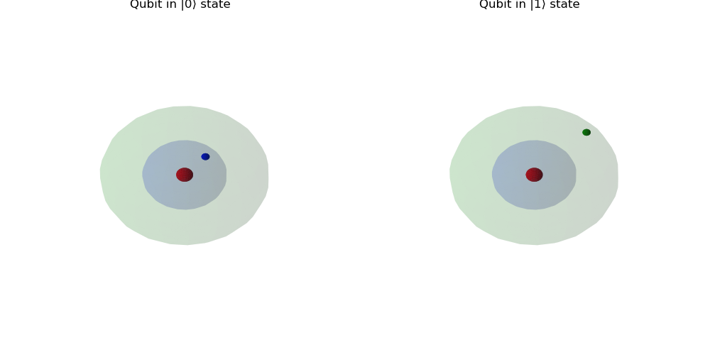

Slide 35
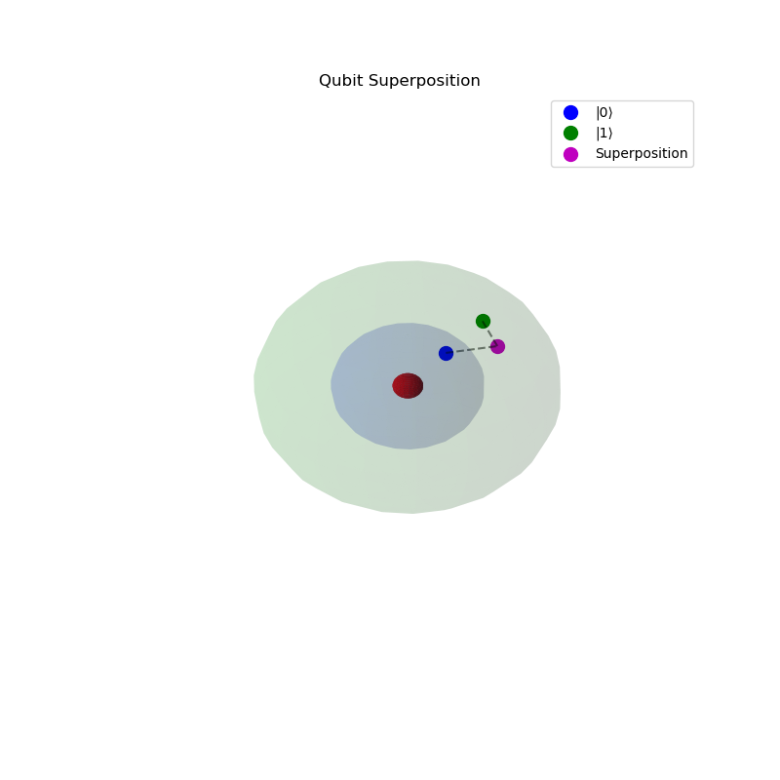

Slide 36
Little
Physics

Slide 37
A QD -Wire System - Topological phase
Assume we use QDs confinement and tunability and combine them with nanowires
The nanowire-QD system is highly stable, and tunable, hence we can fine-tune the electronic properties
Topological superconducting phase - It is used for superconducting sensors and low power devices.
If we add to this settings a tool that can measure the parity of the electrons on the nanowire we can have a new type of stable qubit

Slide 38
Fermions
What is a Fermion?
A fundamental particle which is the core building block of all matter.
Examples of Fermions:
Electrons, protons, and neutrons are all fermions
Fermion Properties in Quantum Systems:
They have half-integer spin (e.g., 1/2, 3/2) and obey Fermi-Dirac statistics, crucial for quantum mechanics and solid-state physics.

Slide 39
Fermion -Spin ½

Slide 40
Dirac Equation - 1928
Motivation for the Dirac Equation
Quantum mechanics successfully described fermions, but there was no lack of consistency with special relativity.
Dirac sought an equation that naturally included spin-1/2 particles and predicted their behavior at high speeds.
His equation also predicted antimatter, an entirely new concept at the time.

Slide 41
Majorana Equation -1937
Dirac Equation has complex solutions that were interpreted as a particle and its antiparticle.
Majorana, motivated by a desire for a simpler, more 'real' description of particles, searched for a more elegant solution and rewrote the Dirac operator in a Hermitian form in order to study real solutions.
Physics interpreted his work as a prediction of a particle that is its own antiparticle, known as a Majorana fermion.

Slide 42
Majorana Zero Modes (MZMs) vs. Majorana Fermions
Majorana fermions are fundamental particles that are their own antiparticles. These are theoretical particles in high-energy physics (e.g., hypothesized for neutrinos), but they have never been observed experimentally.
MZMs are quasiparticles (not fundamental). They emerge from the collective behavior of electrons
MZMs come in pairs: two MZMs at the ends of a wire (or similar systems) are required to form a single Majorana mode.
MZMs exhibit Majorana-like behavior because they are self-conjugate

Slide 43
Fermion Parity
Majorana zero modes (MZMs) always appear in pairs.
The fermion parity of MZMs refers to whether the number of MZM pairs in a system is even or odd. This parity is protected by the topological phase
We can use this this parity to encode a topological qubit. The even or odd parity states represent the |0⟩ and |1⟩
Due to the topological phase. The parity is robust against local perturbations. This provides a form of error protection, making it a cardinal feature for topological quantum computing.

Slide 44
Braiding
Braiding refers to the process of interchanging the positions of Majorana Zero Modes (MZMs) typically done in systems like nanowires or quantum dots
It involves moving MZMs around each other in a controlled manner, which changes the system’s global quantum state.
Braiding allows for the manipulation of fermion parity and enables the measurement of even fermion parity, which would otherwise be inaccessible in a single wire.
Braiding enables us to overcome the limitation of single-wire systems, and achieving robust quantum states—this is fundamental for topological quantum computing.
Since it is robust it can be beneficial for logical qubits -If one pair is destroyed there are other pairs

Slide 45
Braiding
Braiding- A process of physically moving (MZMs) around each other in a controlled manner.
Braiding allows us to manipulate topological qubits, performing quantum gate operations which manipulate fermion parity and enable its measurement
The topological phase implies robustness on these operations against local perturbations such a small errors in the movement of MZMs. Therefore braiding is valuable for fault-tolerant quantum computing.
By performing specific braiding sequences and then measuring the fermion parity, we can read out the state of the topological qubit.

Slide 46
Braiding
A topological qubits system, in order to be relevant, must have a network of wires or other complex structures. A single wire system is insufficient for the manipulation of topological qubits.
Braiding refers to the process of physically moving Majorana zero modes (MZMs) around each other in a controlled manner within this network of wires. It allows us to manipulate topological qubits, performing quantum gate operations which manipulate fermion parity and enable its measurement
The topological phase implies robustness on these operations against local perturbations such a small errors in the movement of MZMs. Therefore braiding is valuable for fault-tolerant quantum computing.
By performing specific braiding sequences and then measuring the fermion parity, we can read out the state of the topological qubit.

Slide 47
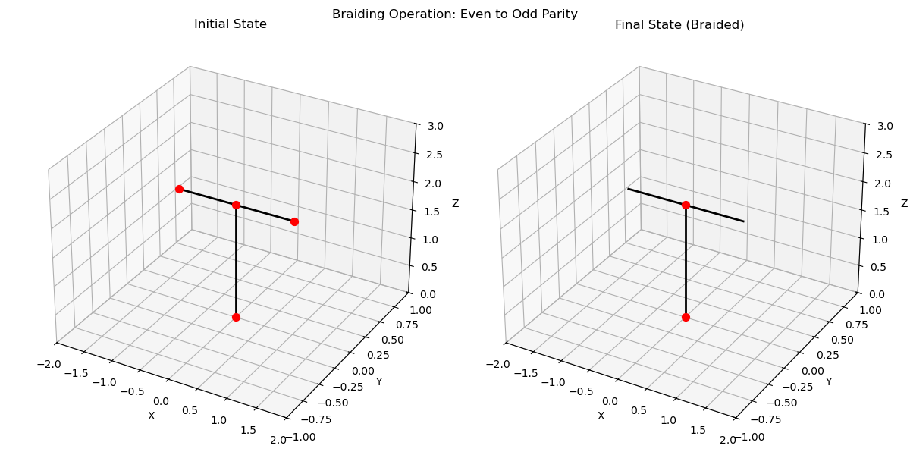

Slide 48
MSN
Majorana 1
2024

Slide 49
From Semiconductor to Topological Superconductor
Semiconductors are materials that have a band gap thus can be tuned to conduct or no, and control electrical conductivity
Superconductors, when cooled below a critical temperature, exhibit zero electrical resistance and expel magnetic fields (Meissner effect)
When a superconductor is brought into a semiconductor, some properties 'leak' into the semiconductor (the proximity effect)
When we combine the proximity effect with magnetic field (Zeeman effect) , we achieve a transition that the wire becomes topological superconductor (topological superconductor phase)
A topological superconductor can host MZMs at its boundaries and they are topologically protected, meaning they are robust against local perturbations

Slide 51
Majorana 1: Creating the Topological Superconductor
A semiconductor nanowire (e.g., InAs) with nanometer diameter and micrometer length (3-4 μm) is fabricated
A superconducting material (e.g., Al) is attached to the nanowire
The superconducting proximity effect induces a 'soft' superconducting gap in the nanowire electronic spectrum
A quantum dot is integrated to provide precise electrostatic control, acting as a 'tuning knob' for the nanowire's properties, specifically tuning the initial superconducting gap
First energy gap is generated

Slide 52
Majorana 2 Generating and Detecting (MZMs)
Using Zeeman effect MSN perform a translation to the topological superc. phase that reopens the energy gap
MZMs are generated at the edges of the nanowires
MSN use the QD to finetune the gaps and enhance the MZMs stability
Performing fermion parity measurement- Tunneling Measurements: Measuring tunneling current through the QD, which is sensitive to MZM presence and parity

Slide 53
Readout -Fermion Parity via Quantum Dot (QD) Sensing
The QD, utilizing its semiconducting properties, is placed close to the nanowire, enabling electrostatic control.
Voltages applied to the QD control its electrostatic potential and charge state
Changes in MZM fermion parity induce changes in the nanowire's charge distribution, affecting the QD's charge state.
Directly measuring the QD's charge state to infer fermion parity
Tunneling Measurements: Measuring tunneling current through the QD, which is sensitive to MZM presence and parity
Challenges and Considerations:
Maintaining MZM topological protection during readout is crucial
Noise and decoherence can impact measurement accuracy
The QD's role is to tune the potential landscape, not to directly block electrons

Slide 54
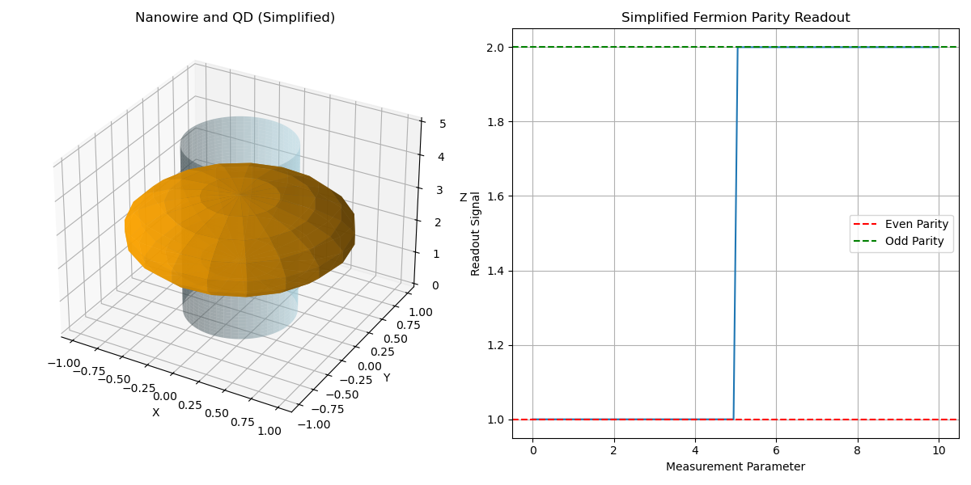

Slide 55
Future improvements
Theoretical study
Non-Abelian Braiding Statistics
Computational modeling
Scalable Architectures and Qubit Networks
Develop multi-qubit systems and design scalable circuits
Integrate with conventional QEC methods
Advanced Braiding Operations
Implement fault-tolerant quantum gates
Develop precise MZM manipulation techniques
System Integration and Control
Bridge topological qubits and classical electronics
Enhance measurement and readout fidelity
Develop efficient control interfaces

